Slide 1

City Emergency Response Management System Project
boxi li wanting wang
zizheng liu zihan liu shu li

Slide 2

1.Introduction
2.Project Structure
3.Backend Design
4.System Features and Use Cases
5.GUI Overview
6.Testing and Coverage
7.Team Roles and Responsibilities
8.Daily Work Schedule
9.Challenges and Lessons Learned
10.Conclusion
contents

Slide 3

01
Introduction

Slide 4
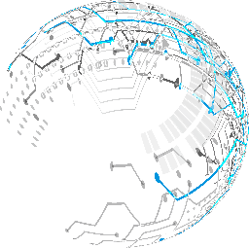
This powerpoint details the design, implementation, and features of the City Emergency Response Management System. The project's core purpose is to provide an efficient and intuitive platform for managing urban emergencies by leveraging and comparing different priority queue data structures. Through this system, we demonstrate the practical application of various data structures, their performance characteristics, and their impact on realworld emergency management scenarios.

Slide 5
02
Project Structure

Slide 6
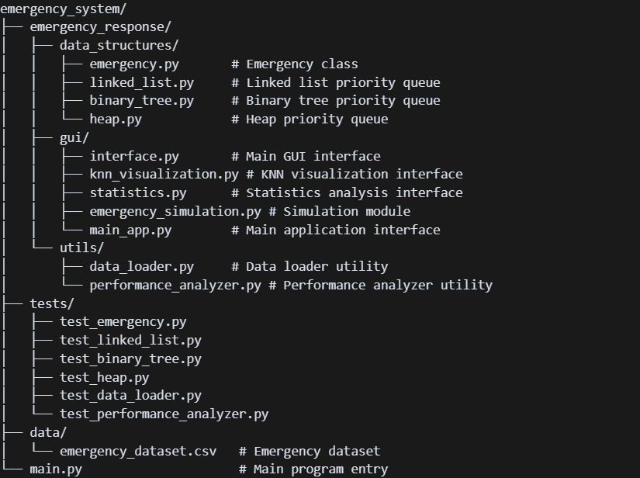

Slide 7
03
Backend Design

Slide 8
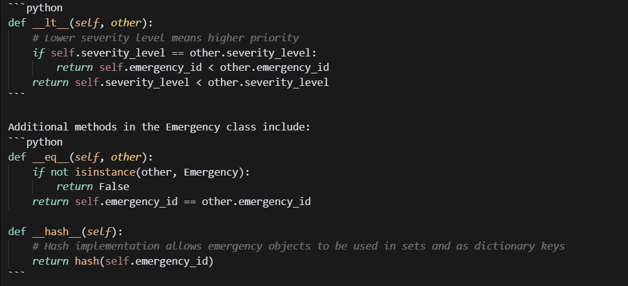
3.1. Emergency Class
The `Emergency` class represents an emergency instance with the following attributes:
- `emergency_id`: Unique identifier for the emergency.
- `type`: Emergency type (using `EmergencyType` enum).
- `severity_level`: Severity (1-10, where 1 is the most severe/highest priority).
- `location`: Location description.
- `coordinates`: Location coordinates (x, y).
The class implements comparison operators to prioritize emergencies by severity, then by ID:

Slide 9
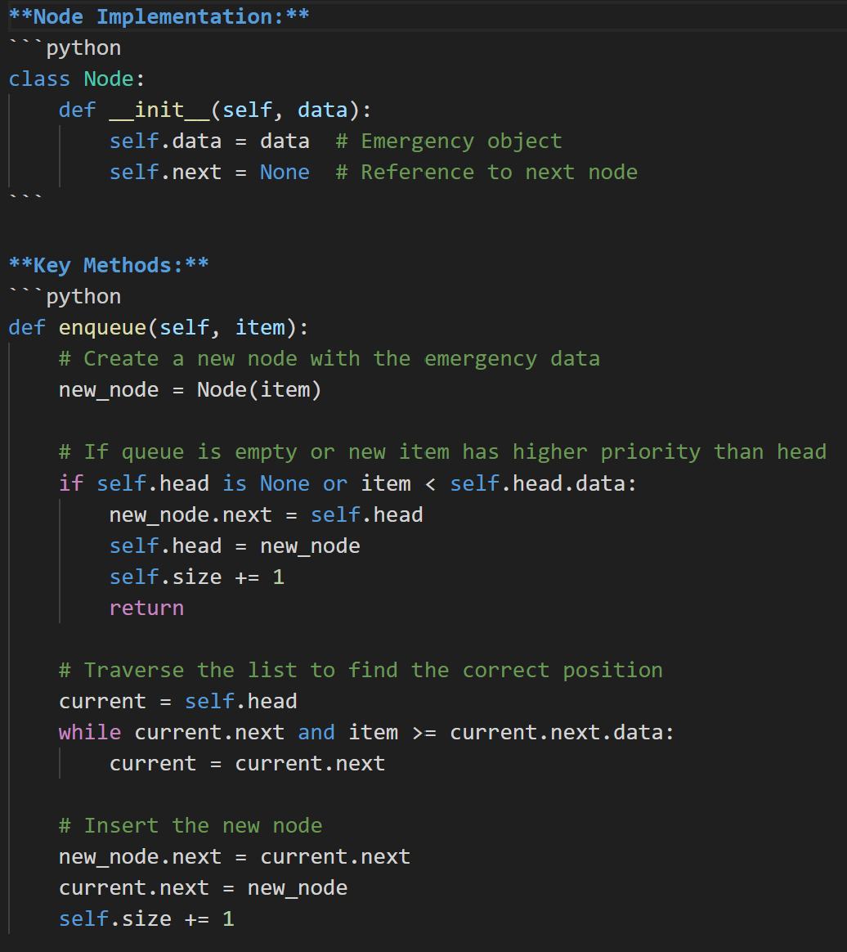
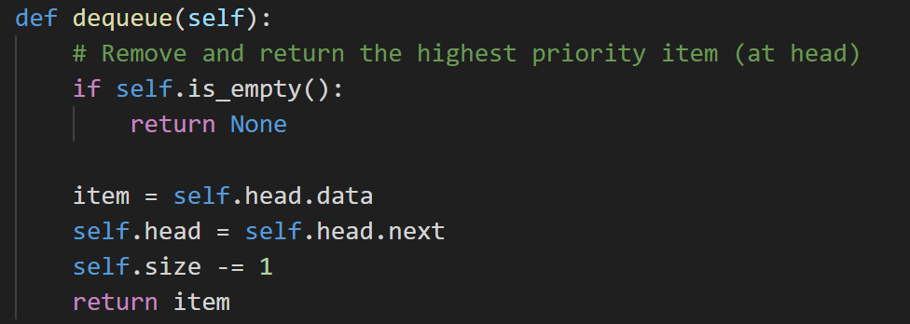
3.2. Priority Queue Data Structures
3.2.1. Linked List Implementation (LinkedListPriorityQueue)
Our linked list implementation uses a custom `Node` class and maintains a sorted list where the highest priority element (lowest severity) is always at the head.

Slide 10
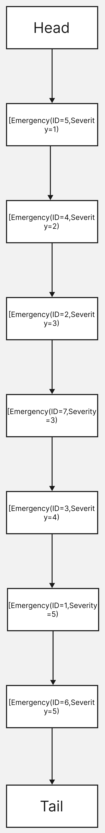
5.2. Priority Queue Data Structures

Slide 11
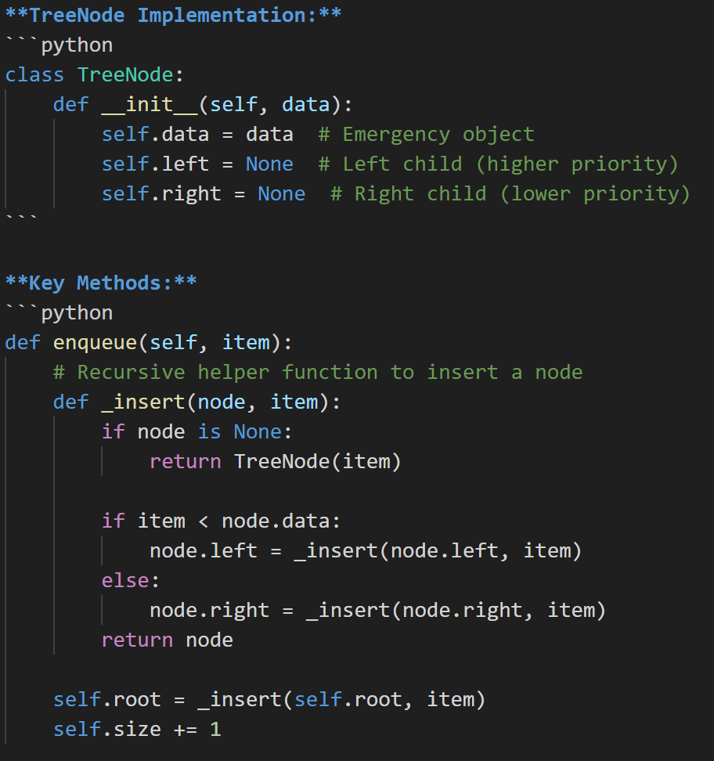
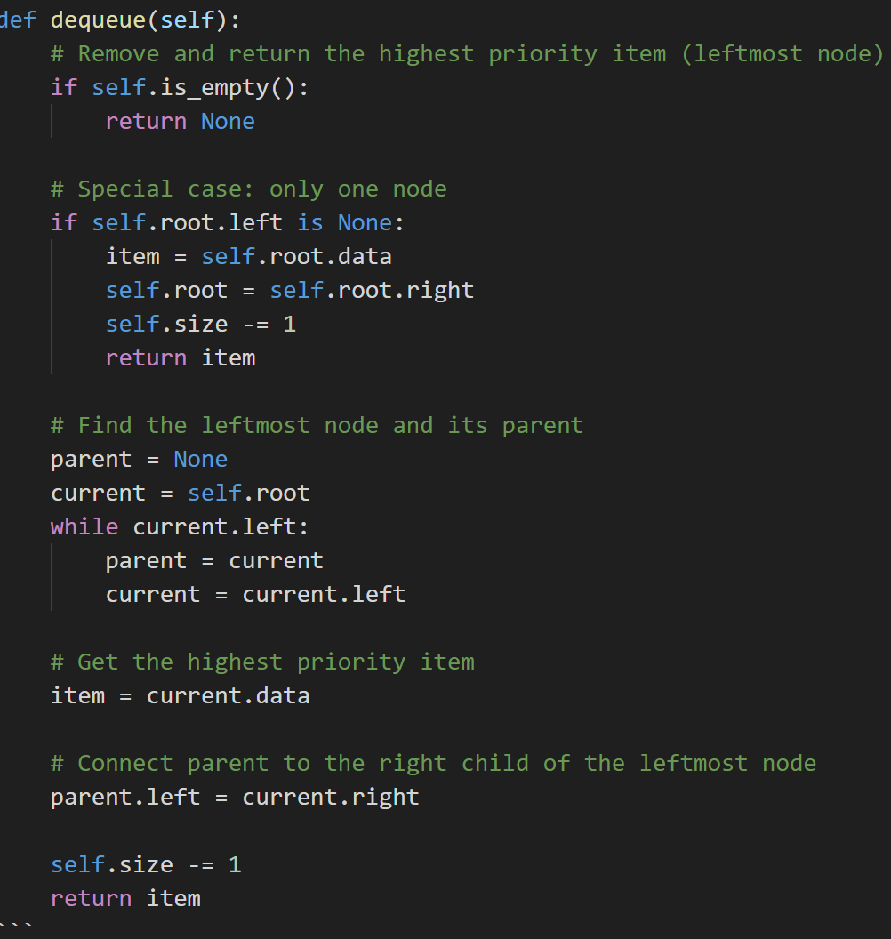
3.2.2. Binary Tree Implementation (BinaryTreePriorityQueue)
Our binary search tree implementation uses a custom `TreeNode` class and maintains a tree where nodes are ordered by emergency priority.

Slide 12
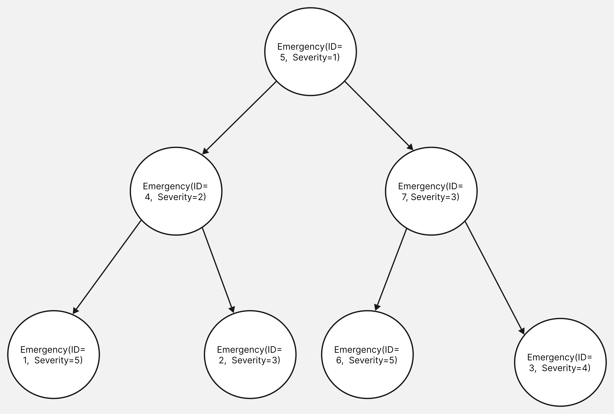
3.2.3. Heap Implementation (HeapPriorityQueue)

Slide 13
3.2.2. Binary Tree Implementation (BinaryTreePriorityQueue)
Our binary search tree implementation uses a custom `TreeNode` class and maintains a tree where nodes are ordered by emergency priority.

Slide 14
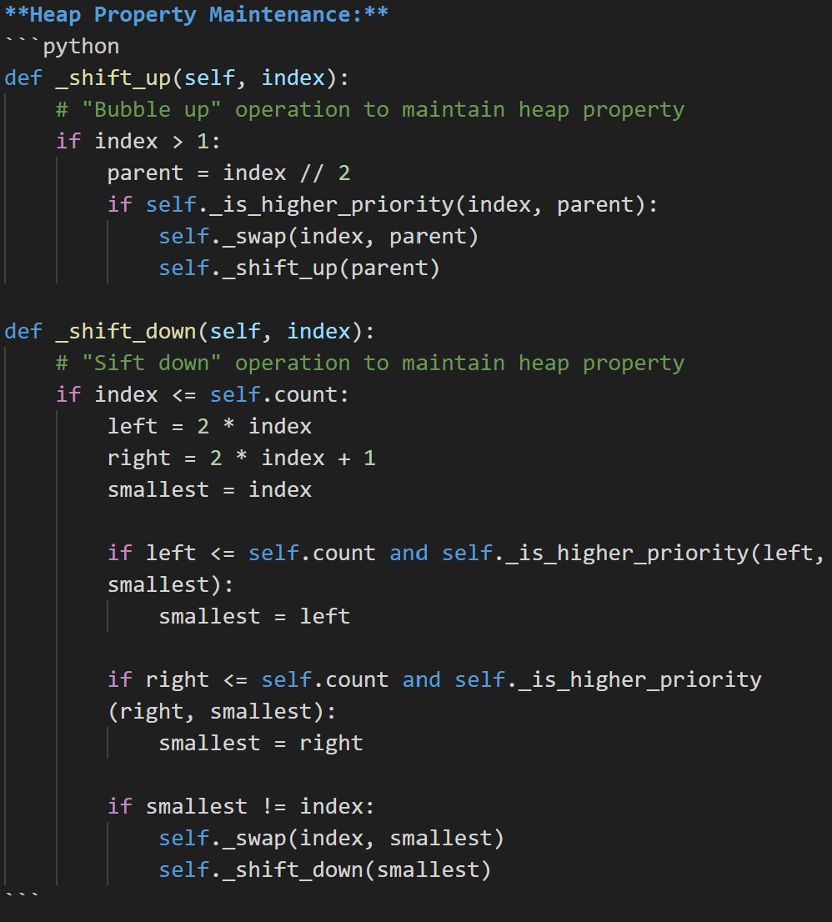

Slide 15
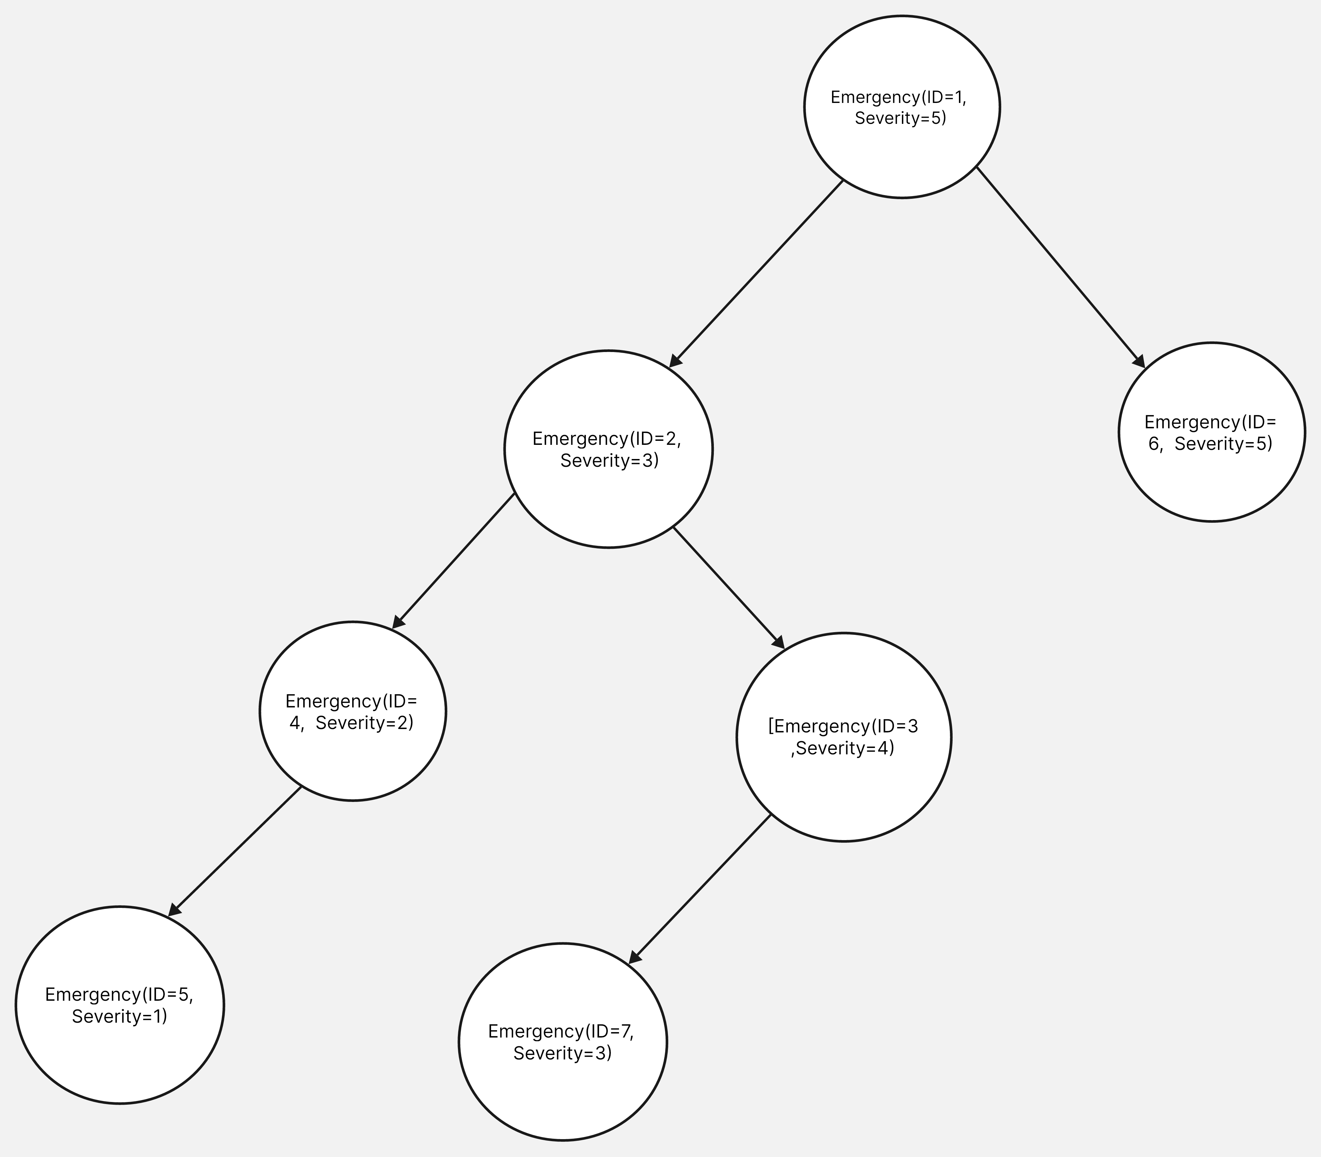

Slide 16
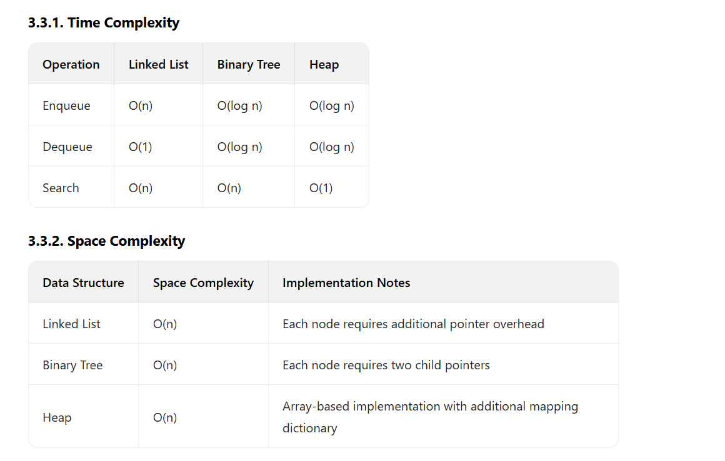
3.3. Complexity Analysis
Our measurements using the pympler library confirm these theoretical complexities, with some interesting observations:
- The linked list structure shows consistent memory usage regardless of the number of elements
- The binary tree's memory growth tapers off as the tree size increases
- The heap structure shows the most linear relationship between memory usage and data size

Slide 17
3.4. Design Rationale and Reflections on Optimization
In developing this project, we gave special consideration to how we used our data structures and the overall efficiency of the system.
3.4.1. Our Current Design and Its Justification
In the current implementation, we decided to maintain three separate instances of our priority queues (`LinkedList`, `BinarySearchTree`, and `Min-Heap`) simultaneously.
Our Rationale:
This decision was made primarily for comparative purposes. We wanted to build a system where a user could easily switch between different views and observe, in real-time, how each data structure behaves with the exact same dataset.
Acknowledged Trade-offs:
Data Redundancy: Every emergency object is stored three times, tripling the memory footprint.
Performance Overhead: Write operations are less efficient, as they must be executed three times.

Slide 18
3.4.2. Reflections on Future Optimizations
If we were to refactor this project for a real-world production environment, we would implement a more efficient design.
1. A Single Source of Truth: Use a hash map (a Python dictionary) for `O(1)` average time complexity lookups by `emergency_id`.
2. On-Demand Instantiation: Dynamically create the active priority queue from the hash map only when needed.
3.Balanced BST: Implement a self-balancing binary search tree (like AVL or Red-Black) to guarantee O(log n) operations.
4. Rebuilding on Switch: If the user switches views, dynamically build the new queue from the hash map.
This optimized design would eliminate data redundancy and restore the efficiency of write operations.

Slide 19
04
System Features and Use Cases

Slide 20
4.1. Main Features
1. Emergency Management: Add, process, and search for emergencies using three different priority queue implementations.
2. KNN Visualization: Visualize emergencies and response units on a map and recommend the nearest units.
3. Statistical Analysis: Analyze emergency type and severity distributions.
4. Performance Comparison: Compare the operational performance of the three data structures.
5. Emergency Dispatch Simulation: Simulate handling large-scale emergencies to compare data structure performance.
6. Space Complexity Analysis: Measure and visualize memory usage of different data structures.

Slide 21
4.2. Application Scenarios
1. City Emergency Centers: Managing and dispatching resources for various incidents.
2. Hospitals: Optimizing patient intake and resource allocation.
3. Fire Departments: Handling alarms and dispatching units efficiently.
4. Police Departments: Managing and responding to emergency calls.

Slide 22
05
GUI Overview

Slide 23
5.1. Interface Description
The GUI, built with tkinter, includes:
1.Main Interface: A central hub with access to all major functions.
2.Emergency Management Interface: Allows direct interaction with the priority queues.
3.KNN Visualization Interface: Maps emergencies and recommends response units.
4.Statistical Analysis Interface: Displays emergency data distributions and complexity information.
5. Performance Comparison Interface: Compares the performance of the data structures with charts.
6. Emergency Dispatch Simulation:Simulates handling large batches of emergencies with different data structures, showing real-time processing speeds, queue states, and memory usage visualization across different data sizes.

Slide 24
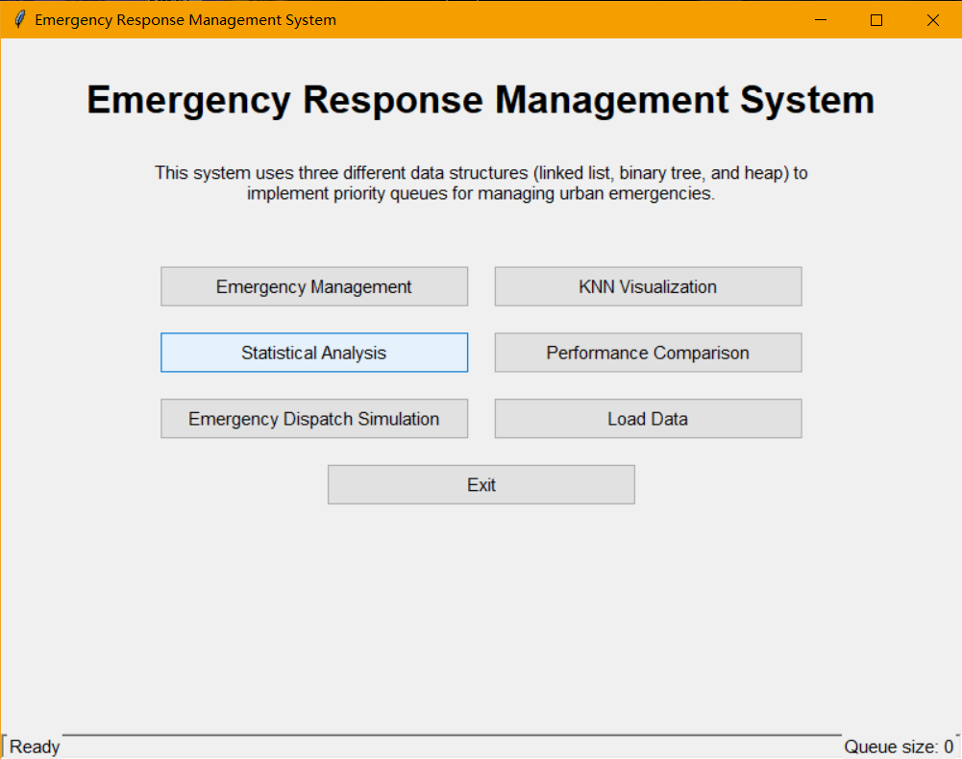
Main Interface

Slide 25
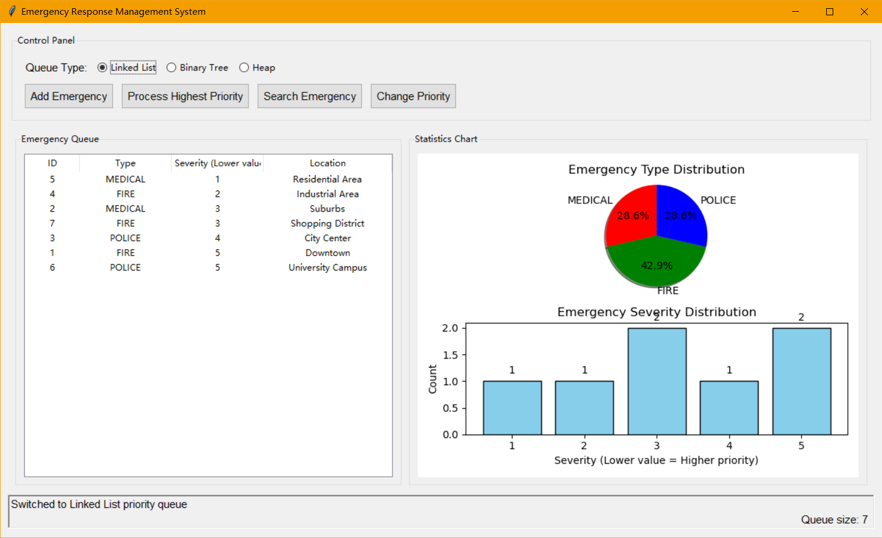
Emergency Management Interface(linked list)

Slide 26
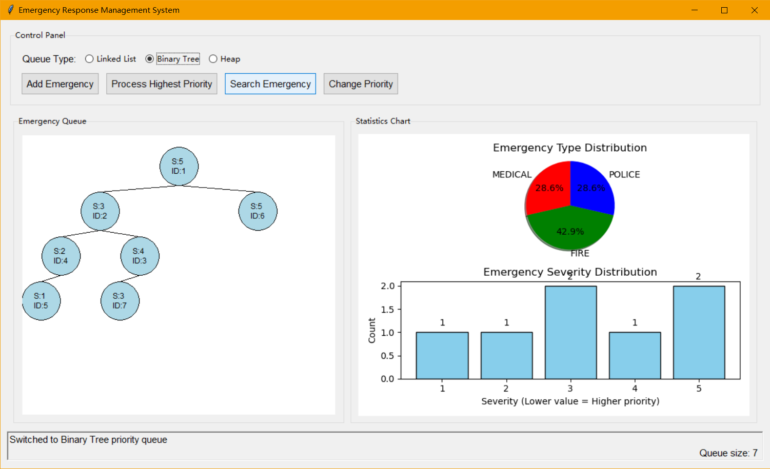
Emergency Management Interface(binary tree)

Slide 27
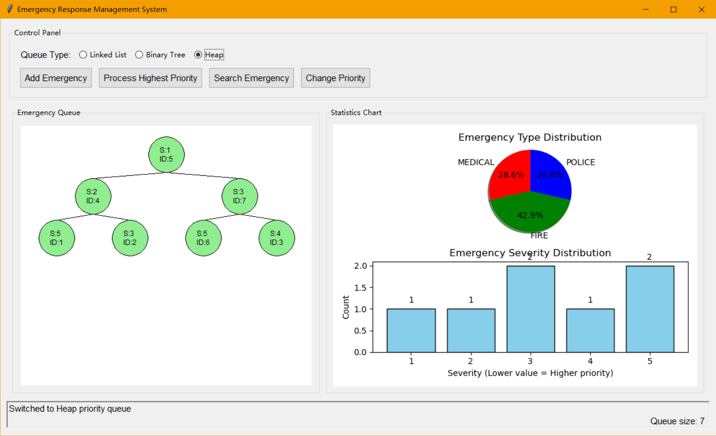
Emergency Management Interface(min heap)

Slide 28
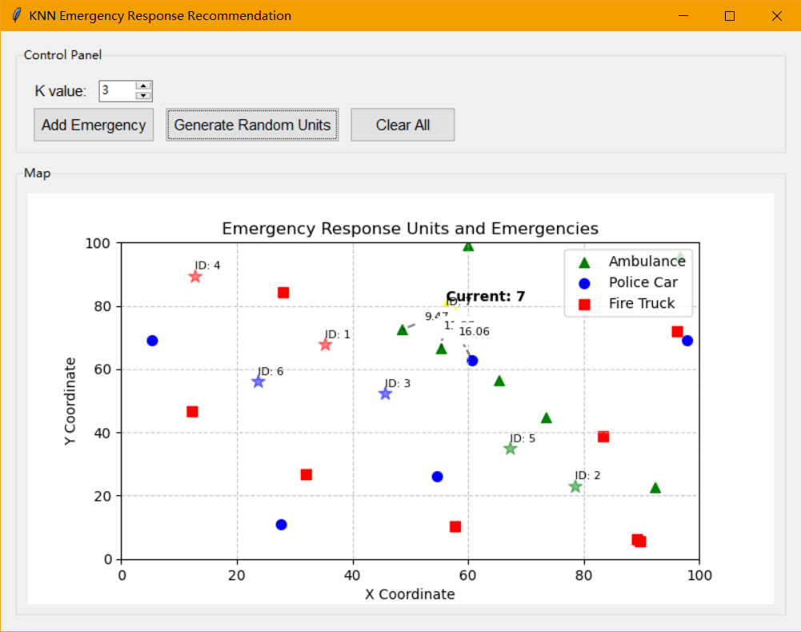
KNN Visualization Interface

Slide 29
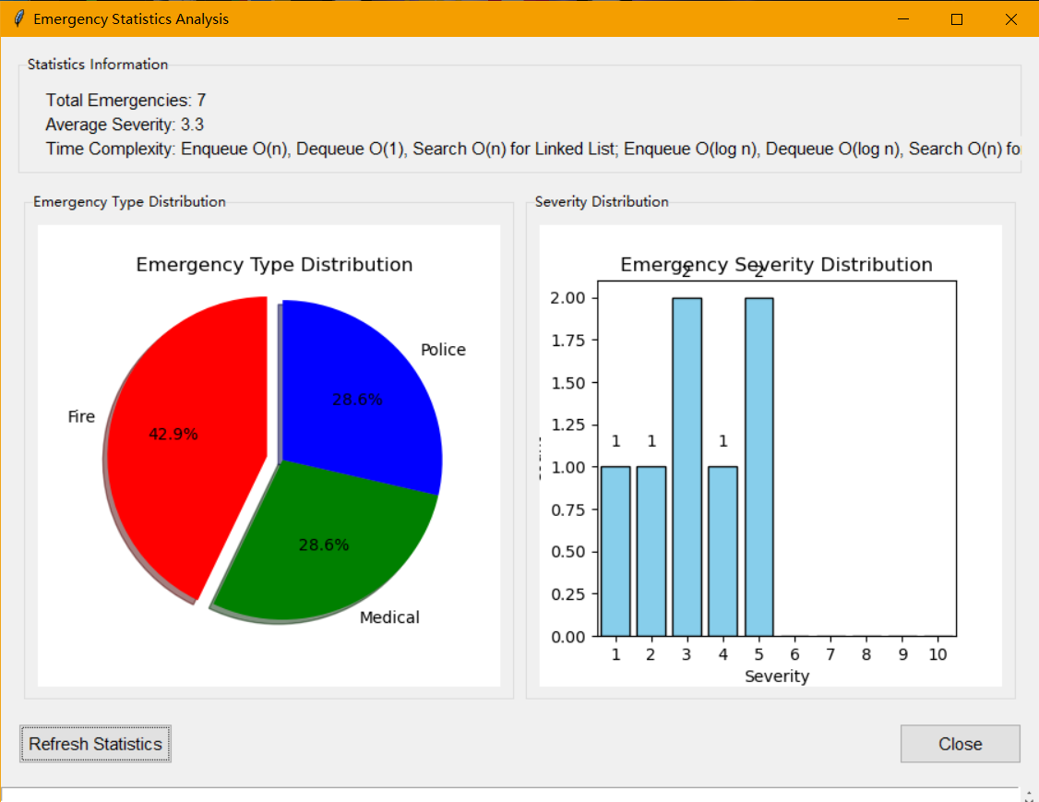
Statistical Analysis Interface

Slide 30
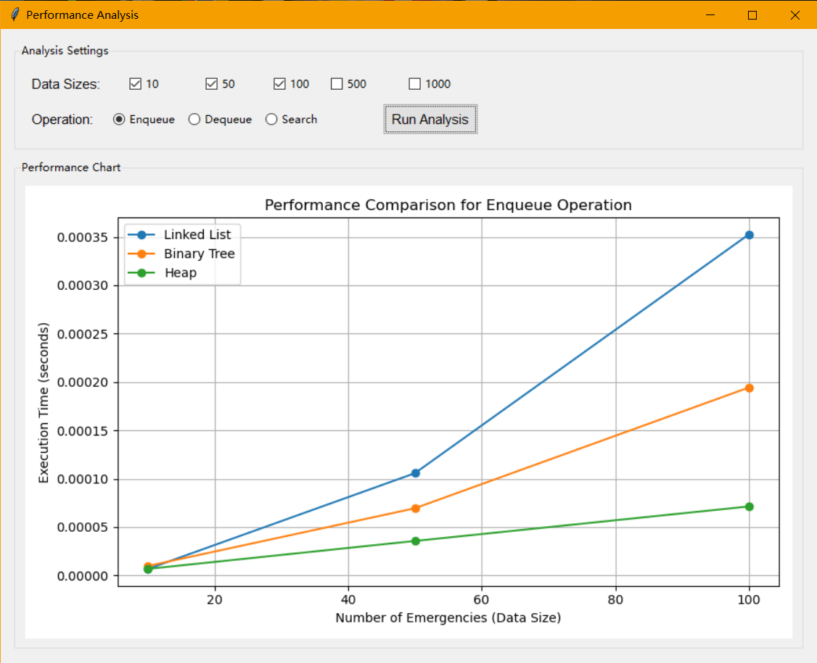
Performance Comparison Interface

Slide 31
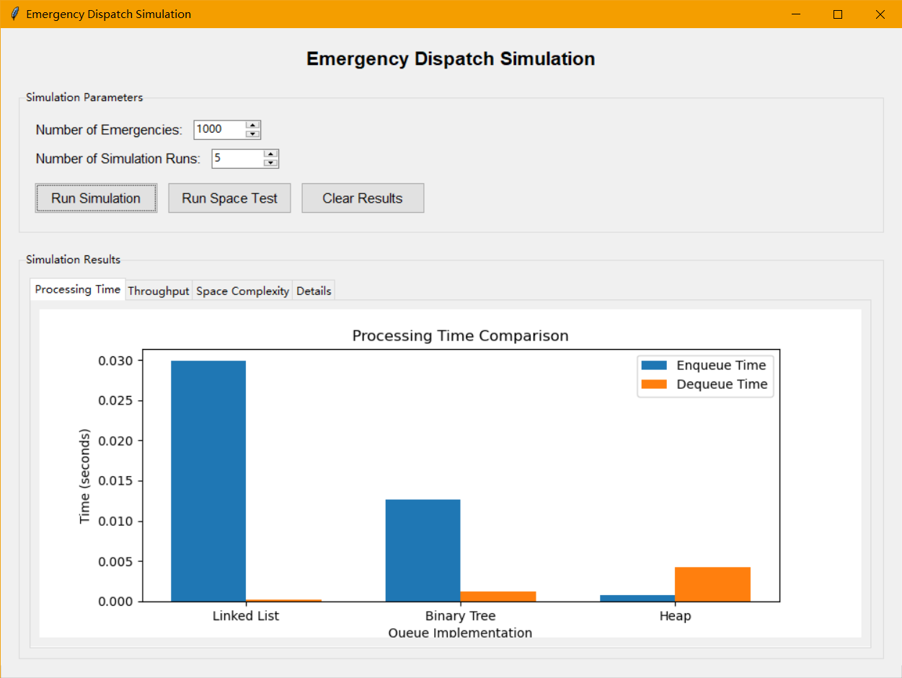
Emergency Dispatch Simulation

Slide 32
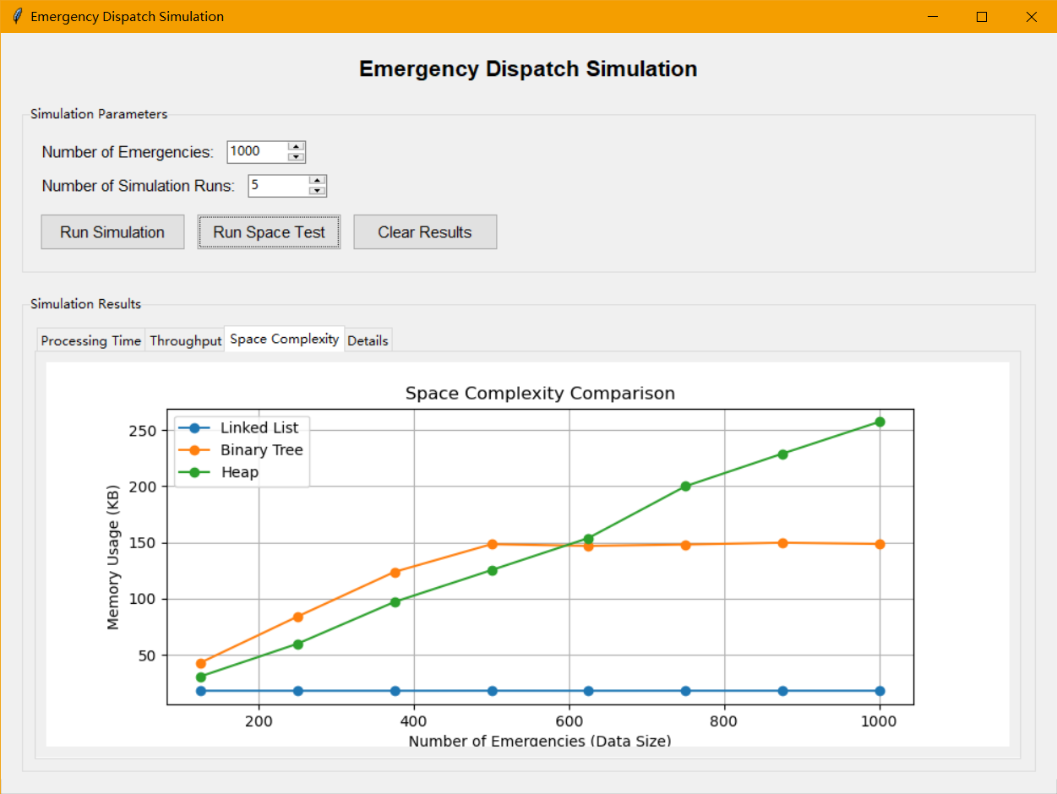
Emergency Dispatch Simulation

Slide 33
5.2. Suggestions for Improvement
1.Enhanced Visualization: Implement heatmaps for emergency density or animations for response unit movements.
2.Improved User Guidance: Add an interactive tutorial or contextsensitive help tips.

Slide 34
06
Testing and Coverage

Slide 35
6.1. Testing Framework
The project uses Python's builtin unittest framework for all unit tests.
6.2. Test Coverage
The test suite covers all core data structures and utility functions, including edge cases and basic operations. The overall project test coverage is 86%, ensuring high reliability of the core functionalities.

Slide 36
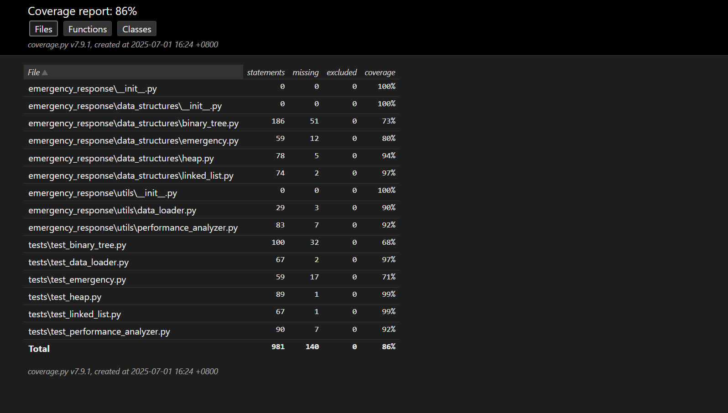

Slide 37
| Test File | Coverage
test_emergency.py| Emergency class initialization and comparison
test_linked_list.py | Linked list queue operations and edge cases
test_binary_tree.py | Binary tree queue operations and structure
test_heap.py | Heap queue operations and performance
test_data_loader.py | Data loading and queue initialization
test_performance_analyzer.py| Performance analyzer functionality

Slide 38
07
Team Roles and Responsibilities

Slide 39
Name | Main Responsibilities
Li Boxi | Core architecture & data structures: Responsible for all core data structure implementations (binary_tree.py, heap.py, linked_list.py, emergency.py); main program architecture design (main.py); GUI and data structure integration; drawing data structure flowcharts
Liu Zhihan| GUI Development (Part 1): Develop main interface (interface.py); main application (main_app.py); emergency simulation module (emergency_simulation.py)
Liu Zizheng| GUI Development (Part 2): Develop custom dialogs (custom_dialogs.py); statistics module (statistics.py); KNN visualization module (knn_visualization.py)
Li Shu | Data Processing & Simulation: Develop data loader (data_loader.py); dataset preparation and management (emergency_dataset.csv); performance analyzer module (performance_analyzer.py)
| Wang Wanting| Testing & Documentation: Write all unit tests; system documentation; user manual (readme.md)

Slide 40
08
Daily Work Schedule

Slide 41
emergency response systems
Day 1: Project planning and requirement gathering.
Day 2: Designing the system architecture and data structures.
Day 3: Implementing the main application and GUI.
Day 4: Developing the KNN algorithm and visualization.
Day 5: System testing and integration.
Day 6: Debugging and bug fixing.
Day 7-9: Finalizing the project, creating the presentation, and writing this report.

Slide 42
09
Challenges and Lessons Learned

Slide 43
9.1. Main Challenges
1. Data Structure Selection: Balancing the performance tradeoffs between the linked list, binary tree, and heap.
2. Data Consistency: Ensuring data remained synchronized across all three data structures during operations.
3. Performance Optimization: Addressing potential bottlenecks, such as tree balancing and efficient heap updates.
4.GUI Performance: Ensuring the GUI remained responsive when visualizing large datasets.

Slide 44
9.2. Lessons Learned
1. Design for Edge Cases：The importance of considering special conditions, such as identical priorities.
2. TestDriven Development: High test coverage is crucial for ensuring code quality and reliability.
3.Balance Performance and Maintainability: Choose implementations appropriate for the specific use case.
4. Modular Design: A clear separation of concerns makes the project easier to extend and maintain.

Slide 45
10
Conclusion

Slide 46
emergency response systems
This City Emergency Response Management System successfully provides an effective solution for emergency management by implementing and comparing three distinct priority queue data structures. The system's combination of an intuitive visual interface and powerful analysis tools helps demonstrate key computer science concepts and offers a practical framework for optimizing emergency response.

Slide 47
THANKS

